Slide 1

Augmenting Colonoscopy using Extended and Directional CycleGAN
for Lossy Image Translation
陈帅帅
2020.10.08

Slide 2
大肠癌的筛查方式 OC & VC
光学结肠镜检查(OC):是结肠癌筛查程序。在这种侵入性手术中，可以使用内窥镜发现息肉（结肠癌的前体）并去除息肉。OC内窥镜视频由单独的帧组成，这些帧捕获具有重要纹理信息（例如，静脉，血块，粪便等）的结肠的复杂实时动态。
虚拟结肠镜检查(VC):是一种非侵入性筛查程序，其中结肠是通过计算机断层扫描（CT）扫描3D重建的，产生大肠的X光影像并通过虚拟飞越（模拟OC内窥镜检查）检查息肉。具有结构信息。
OC->VC 确定结构、检查息肉
VC->OC 教学、模拟

Slide 3
Contributions
1. A lossy image-to-image translation model via a novel extended cycle consistency loss to remove texture,color and specular highlights from VC.
2. A Directional Discriminator to create a stronger link
between OC and VC for removing remaining textures
and lighting.
3. The same framework can synthesize realistic OC(flat and pendunculated) images.

Slide 4
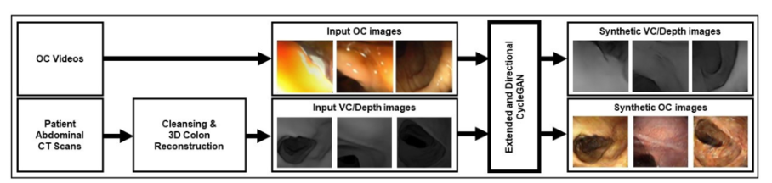
Datasets

Slide 5
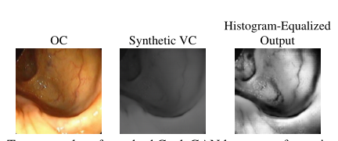
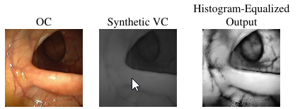
Cycle gan

Slide 6
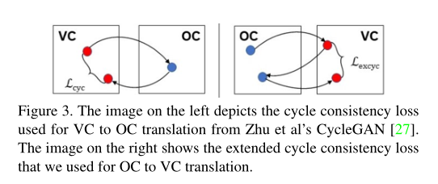
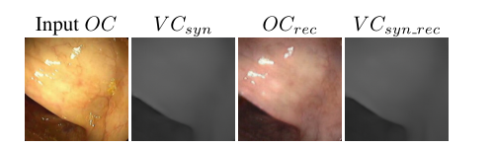

Consistency loss

Slide 7
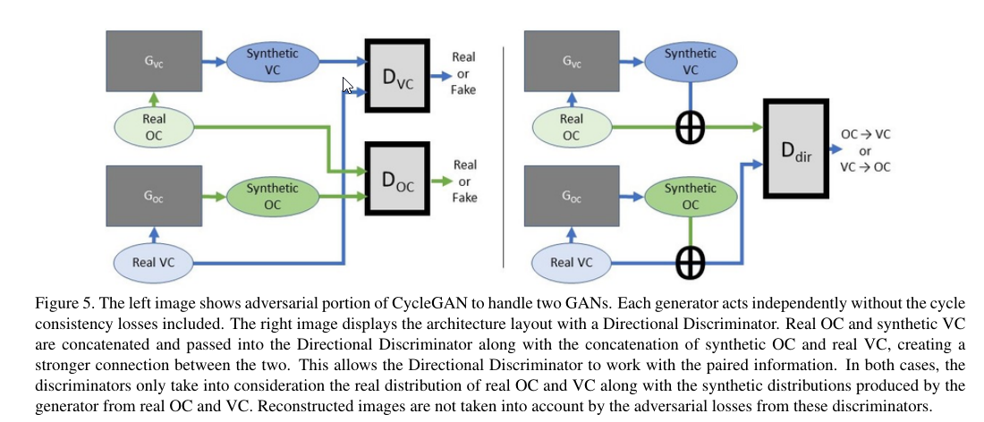
Datasets—MR(T1)

Slide 8
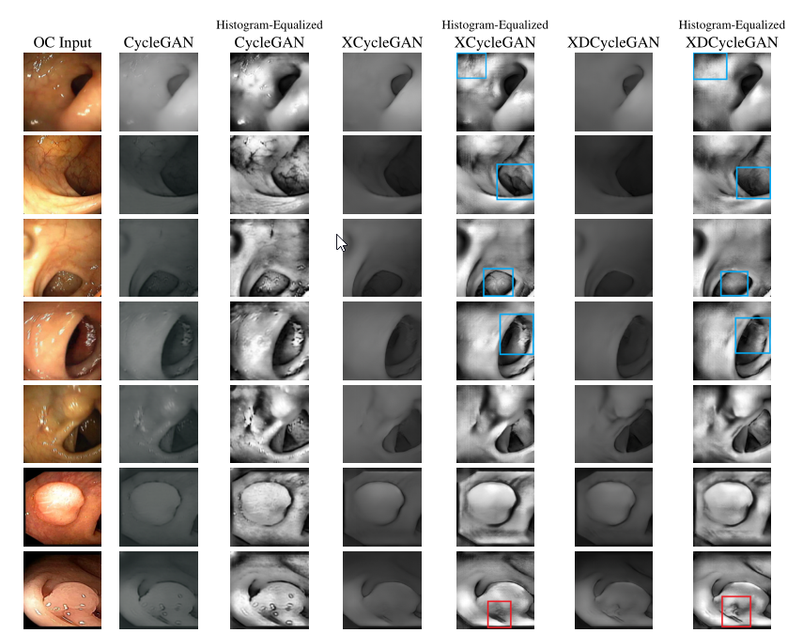
Result

Slide 9
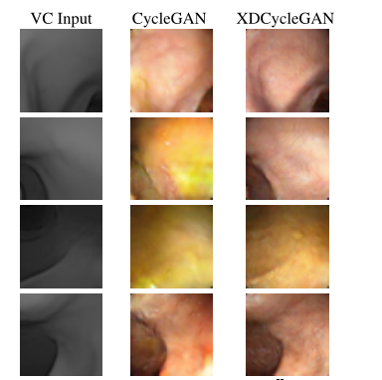
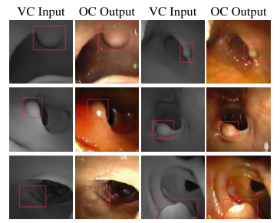
Result

Slide 10
THANKS

